Slide 1
Lecture 8 Binary Search Tree and Trie
Department of Computer Science
Hofstra University

Slide 2
Lecture Goals
Describe the value of trees and their data structure
Explain the need to visit data in different orderings
Perform pre-order, in-order, post-order and level-order traversals
Define a Binary Search Tree
Perform search, insert, delete in a Binary Search Tree
Explain the running time performance to find an item in a BST
Compare the performance of linked lists and BSTs
Explain what a trie data structure is

Slide 3
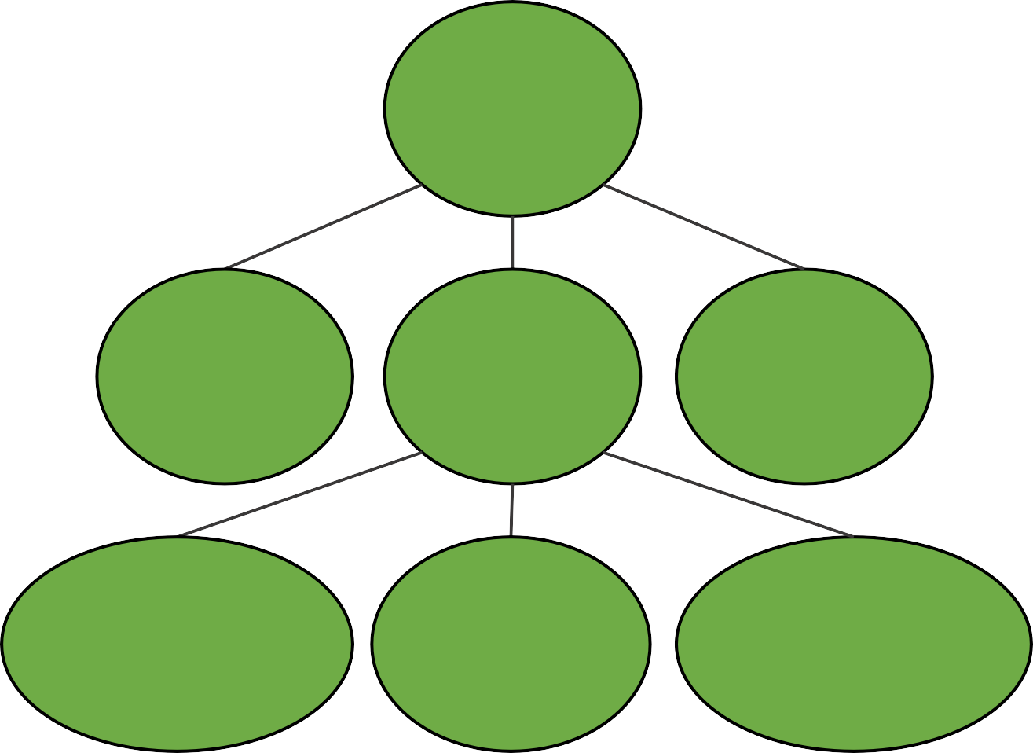
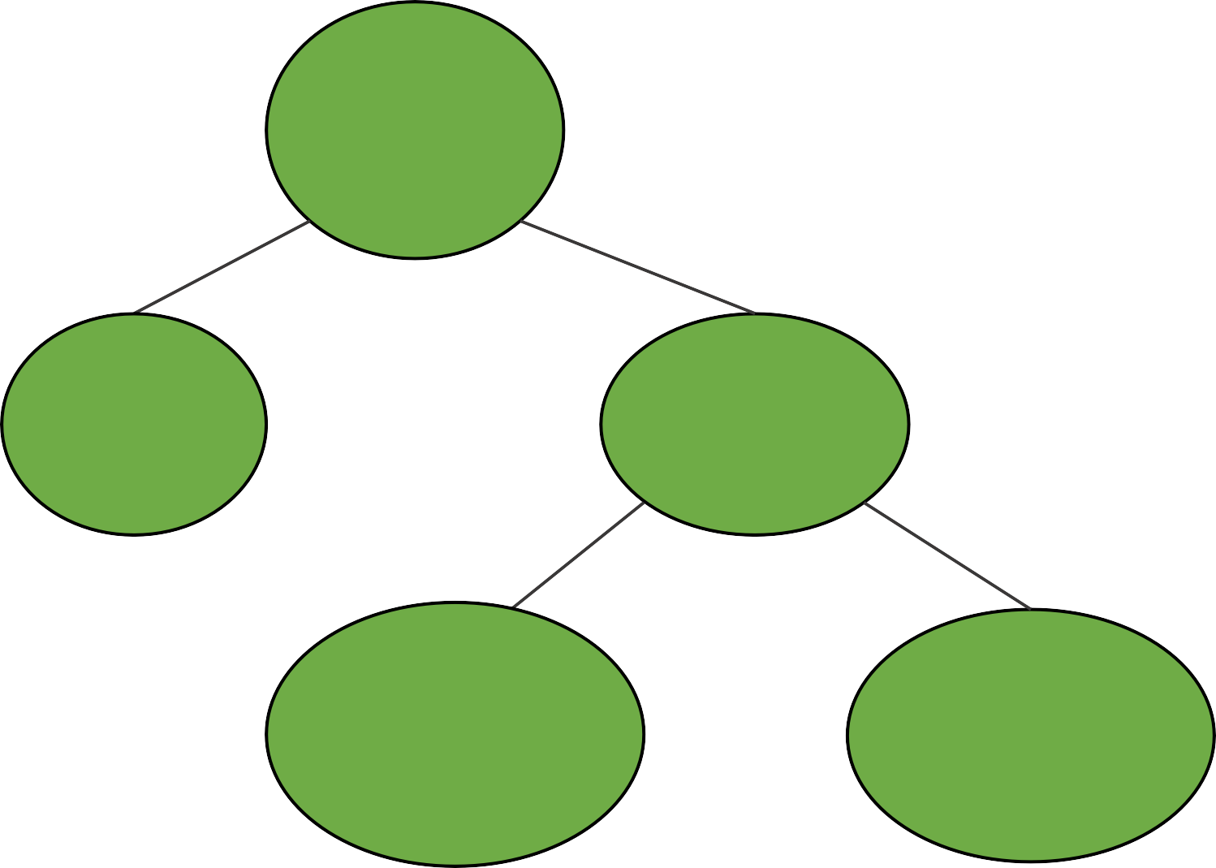
Different Trees in Computer Science
House
clean
Root is most important (Heap)
Organized by character frequency (Huffman Tree)
Organized by node ordering (Search Trees)
Etc…
parent
Tywin
No
Yes
Tyrion
Cersei
children
Floor
Clean?
Jaime
Relax
No
Yes
Myrcella
Joffrey
children
of children
Wash
Windows
Sweep Floor
Tommen
Family Trees
Why trees?
Different Organizations → Different Trees
Decision Trees
/
Evaluate: 45 / (3 + 6)
/
/user/porter
Structure conveys information
45
+
etc/
users/
3
6
porter/
minnes/
alvarado/
Expression Trees
File System
Dynamic Data Structure

Slide 4
Defining Trees
has no parent node
root
What defines a tree?
Single root
Each node can have only one parent (except for root)
No cycles in a tree
Tywin
parent
only has one parent
Tyrion
Cersei
Jaime
child
Myrcella
Joffrey
Tommen
leaf
Which are trees?
nodes without children
Family Trees
A
root
✓
B
C
D
E
two roots
root
root
✓
✓
two
parents
✗
two
parents
✗
3 children (all leaves)
leaf
Cycle: two different paths
between a pair of nodes

Slide 5
Binary Trees
Generic Tree
Any Parent can have any number of children
Tywin
A general tree would just have a list for children
Tyrion
Cersei
Jaime
How would a general tree node differ?
Myrcella
Joffrey
Tommen
Binary Tree
Any Parent can have at most two children
A tree just needs a root node
root
Tywin
like the head and tail for linked list
How do we construct a tree?
Each node needs:
A value
A parent
A left child
A right child
Tyrion
Cersei
Like Linked Lists, Trees have a "Linked Structure"
Joffrey
Tommen
nodes are connected by references

Slide 6
Write Code for Binary Tree
public class BinaryTree<E> {
TreeNode<E> root;
// more methods
}
root
A
public class TreeNode<E> {
private E value;
private TreeNode<E> parent;
private TreeNode<E> left;
private TreeNode<E> right;
public TreeNode(E val, TreeNode<E> par) {
this.value = val;
this.parent = par;
this.left = null;
this.right = null;
}
public TreeNode<E> addLeftChild(E val) {
this.left = new TreeNode<E>(val, this);
return this.left;
}
}
A
Let's write a constructor together
For root: TreeNode(val, null)
Next Step is to able to set/get children

Slide 7
Height of a Tree
The height of a tree is defined as the number of edges in the longest path from the root node to a leaf node.
For a tree with only a root node, the height is 0.
For the tree below, the height is 2.
1
1
4
2
8

Slide 8
Full Binary Tree
A full binary tree with height h has a total number of nodes given by the formula: n = 2^{h+1}−1
This formula arises because, in a full binary tree, each level is completely filled. The number of nodes at each level l is 2^{l}. Therefore, the total number of nodes is the sum of nodes at all levels from 0 to h, which is a geometric series: n=1+2+4+…+2^{h}=2^{h+1}-1
This means that for a full binary tree, the total number of nodes grows exponentially with the height of the tree
h=0: n=2¹−1=1
h=1: n=2²−1=3
h=2: n=2³−1=7
1
4
4
4
1
2
8
2
8
2
8
h=0
h=1
h=2
Notes:
A full binary tree with height hh has a total number of nodes given by the formula:2h+1−12h+1−1
This formula arises because, in a full binary tree, each level is completely filled. The number of nodes at each level ll is 2l2l. Therefore, the total number of nodes is the sum of nodes at all levels from 0 to hh, which is a geometric series:1+2+4+…+2h=2h+1−11+2+4+…+2h=2h+1−1
This means that for a full binary tree, the total number of nodes grows exponentially with the height of the tree1
3
.
Share
Rewrite

Slide 9
Height of a Binary Tree
For a binary tree with n nodes, the height h is bounded by: ⌈log₂(n+1)⌉ - 1 ≤ h ≤ n - 1
⌈⌉ is the ceiling operator. The lower bound represents a perfectly balanced tree, and the upper bound represents a degenerate tree (essentially a linked list).
The height of a tree is equivalent to the maximum depth of any node in the tree.
For a binary search tree, the minimum height with n nodes is ⌈log₂(n+1)⌉ - 1, which occurs in the most balanced configuration, where ⌈⌉ is the ceiling operator, e.g., ⌈1.0⌉=1, ⌈1.3⌉=2
The maximum height of a binary tree with n nodes is n-1, which occurs in the case of a skewed tree (essentially a linked list)

Slide 10

Tree Traversal - Motivation
Warning: These first examples are really graphs. We'll visit graphs in detail in the next course. Here they are used as motivating examples
start
Imagine this is a hedge maze
Strategy: go until hit a dead end, then retrace steps and try again
What's my next step?
Mazes benefit from "Depth First Traversals"
Bottom line: Order we visit matters and we'll make choices based on our needs
finish
Maze Traversal
E
A
B
Suppose you have a list of your friends and each of your friends have lists
F
you
How closely are you connected with D?
C
D
What's my next step?
Strategy: look at all of your friends first, and then branch out.
This problem benefits from "Breadth First Traversals"
Social Network

Slide 11
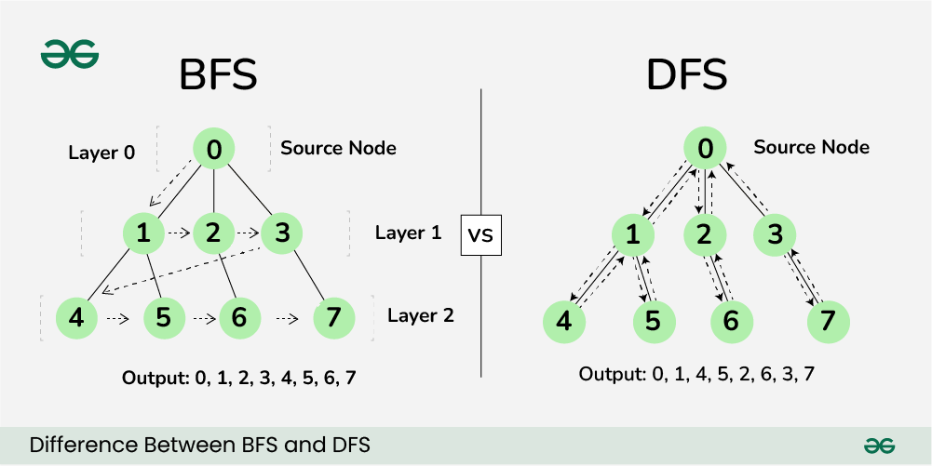
BFS vs. DFS
Breadth-First Search (BFS) and Depth-First Search (DFS) are two fundamental algorithms used for traversing or searching graphs and trees
BFS traversal explores all the neighboring nodes at the present depth prior to moving on to the nodes at the next depth level.
DFS uses backtracking. The deepest node is visited and then backtracks to its parent node if no sibling of that node exists
Breadth First Search (BFS) Animations https://www.youtube.com/watch?v=QUfEOCOEKkc
Depth First Search (DFS) Animations
https://www.youtube.com/watch?v=3_NMDJkmvLo
Tree Traversal Algos // Michael Sambol
https://www.youtube.com/watch?v=iaBEKo5sM7w

Slide 12
Traversal Order for Binary Trees
Breadth First Traversal with BFS
Level Order Traversal
Depth First Traversals with DFS
Pre-order Traversal (Root-Left-Right)
In-order Traversal (Left-Root-Right)
Post-order Traversal (Left-Right-Root)

Slide 13
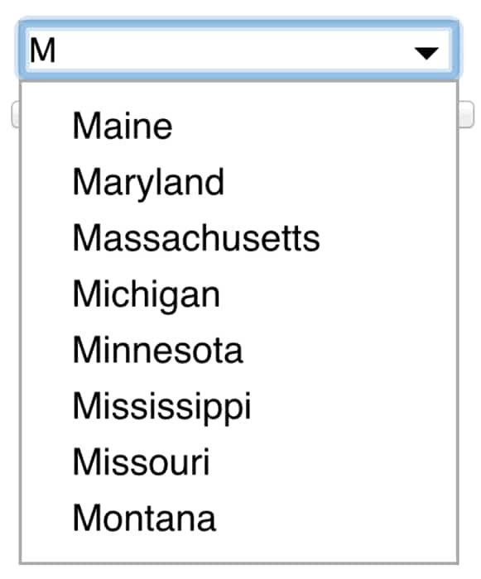
Graph traversal with BFS: Level-order Traversal
You've typed "s" What words should we suggest?
Most frequent?
How about "closest"?
s
so
si
sob
sod
sip
sit
"Breadth First Traversal"
A
Visit:
Level-order
A
B
C
D
E
F
G
B
C
Level-order is
"Breadth First Traversal”
Pre/In/Post Order are:
"Depth First Traversals"
D
E
F
G
Notes:
Most frequent for whom?

Slide 14
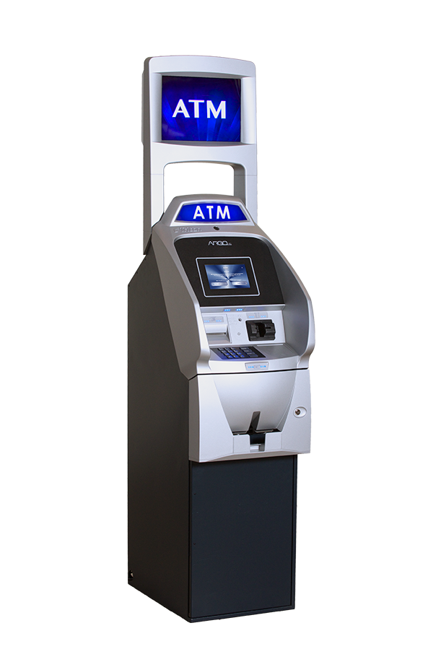
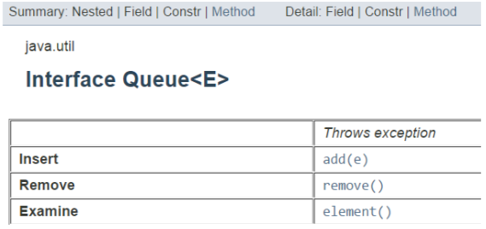
Graph traversal with BFS: Level-order Traversal (Contd.)
Visit:
A
A
B
C
D
E
F
G
Challenging: When we finish B, how do we go to C next?
B
C
D
E
F
G
Idea: Keep a list and keep adding to it and removing from start.
Visit:
A
B
C
D
E
F
G
List:
A
B
C
D
E
F
G
We used this list like a "Queue"
Add to the end
Remove from the front
First-In, First-Out (FIFO)
look at the first element

Slide 15
Level-order Traversal Implementation
Linkedlist implements both list and queue interfaces
public class BinaryTree<E> {
TreeNode<E> root;
public void levelOrder() {
Queue<TreeNode<E>> q = new LinkedList<TreeNode<E>>();
q.add(root);
while(!q.isEmpty()) {
TreeNode<E> curr = q.remove();
if(curr != null) {
curr.visit();
q.add(curr.getLeftChild());
q.add(curr.getRightChild());
}
}
}
}
Could also check for null children before adding

Slide 16
Graph traversal with DFS: pre-order, in-order, post-order
function preOrderTraversal(node) {
if (node !== null) {
visitNode(node);
preOrderTraversal(node.left);
preOrderTraversal(node.right);
}
}
function inOrderTraversal(node) {
if (node !== null) {
inOrderTraversal(node.left);
visitNode(node);
inOrderTraversal(node.right);
}
}
function postOrderTraversal(node) {
if (node !== null) {
postOrderTraversal(node.left);
postOrderTraversal(node.right);
visitNode(node);
}
}
abcdef
cbdaef
cdbfea
Preorder Traversal in Binary Tree Animations https://www.youtube.com/watch?v=gLx7Px7IEzg
Inorder Traversal in Binary Tree Animations
https://www.youtube.com/watch?v=ne5oOmYdWGw
Postorder Traversal in Binary Tree Animations
https://www.youtube.com/watch?v=a8kmbuNm8Uo
Notes:
https://skilled.dev/course/tree-traversal-in-order-pre-order-post-order

Slide 17
Graph traversal with DFS: pre-order, in-order, post-order
Pre-order Traversal Algorithm | Tree Traversal | Visualization, Code, Example
https://www.youtube.com/watch?v=8xue-ZBlTKQ
In-order Traversal Algorithm | Tree Traversal | Visualization, Code, Example
https://www.youtube.com/watch?v=4_UDUj1j1KQ
Post-order Traversal Algorithm | Tree Traversal | Visualization, Code, Example
https://www.youtube.com/watch?v=4Xo-GtBiQN0

Slide 18
Pre-order Traversal (Recursively)
A
This is a recursive process!
Idea:
Visit yourself
Then visit all your left subtree
Then visit all your right subtree
B
C
G
Visited:
D
E
F
A
B
D
E
C
F
G
public class BinaryTree<E> {
TreeNode<E> root;
private void preOrder(TreeNode<E> node) {
if(node!= null) {
node.visit();
preOrder(node.getLeftChild());
preOrder(node.getRightChild());
}
}
public void preOrder() {
this.preOrder(root);
}
}
What’s the order in which you think the nodes will be visited?
Recursion will help us do this!
This can be done iteratively

Slide 19
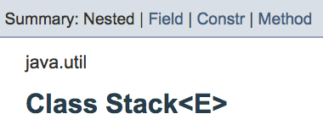
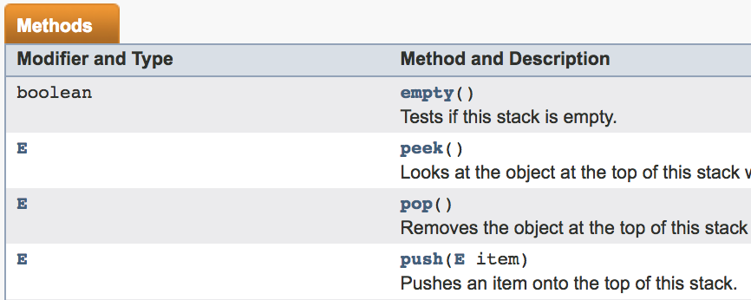
Pre-order Traversal (Iteratively)
Iterative algorithm not covered in exam
A
Challenging: When we finish D, how do we go to E and C next?
B
C
Idea: Keep a list and keep adding to it and removing from end.
D
E
F
G
push
pop
Visit:
A
B
D
E
C
F
G
stack top
List:
stack top
A
C
B
E
D
G
F
We used this list like a ”Stack"
Add to the top
Remove from the top
Last-In, First-Out (LIFO)
PREORDER TRAVERSAL USING A STACK
https://www.youtube.com/watch?v=zvleLiQn-_I

Slide 20
Pre-order Traversal (Iteratively)
public class BinaryTree<E> {
TreeNode<E> root;
void iterativePreorder(TreeNode<E> par) {
if (par == null) { return; }
Stack<TreeNode<E>> nodeStack = new Stack<TreeNode<E>>();
nodeStack.push(par);
while (nodeStack.empty() == false) {
TreeNode<E> node = nodeStack.peek();
node.visit();
nodeStack.pop();
if (node.right != null) {
nodeStack.push(node.right);
}
if (node.left != null) {
nodeStack.push(node.left);
}
}
}
void iterativePreorder() {
iterativePreorder(root);
}
}
1) Create an empty stack nodeStack and push
root node to stack. 2) Do following while nodeStack is not empty. ….a) Pop an item from stack and print it. ….b) Push right child of popped item to stack ….c) Push left child of popped item to stack
Right child is pushed before left child to make
sure that left subtree is processed first.

Slide 21
In-order Traversal (Recursively and Iteratively)
Iterative algorithm not covered in exam
public class BinaryTree<E> {
TreeNode<E> root;
public void Inorder(TreeNode<E> node) {
if (node == null)
return;
Inorder(node.left);
node.visit();
Inorder(node.right);
}
void Inorder() { Inorder(root); }
}
1) Create an empty stack S.
2) Initialize current node as root
3) If current is not NULL, push the current node to S and set current = current->left. Repeat until current is NULL
4) If current is NULL and stack is not empty then
….a) Pop the top item from stack.
….b) Print the popped item, set current = popped_item->right
….c) Go to step 3.
5) If current is NULL and stack is empty then we are done.
Recursive
public class BinaryTree<E> {
TreeNode<E> root;
public void iterativeInorder() {
if (root == null)
return;
Stack<TreeNode<E>> s = new Stack<TreeNode<E>>();
TreeNode<E> curr = root;
while (curr != null || s.empty() == false) {
while (curr != null) {
s.push(curr);
curr = curr.left;
}
curr = s.pop();
curr.visit();
curr = curr.right;
}
}
}
A
Iterative
B
C
D
E
F
G
Visit:
D
B
E
A
F
C
G
Stack:
A
B
D
E
C
F
G

Slide 22
Post-order and In-order Traversal
A
Visit:
Post-order
D
E
B
F
G
C
A
B
C
REARRANGE:
Visit yourself
Visit all your left subtree
Visit all your right subtree
D
E
F
G
Visit all your left subtree
Visit all your right subtree
Visit yourself
Visit:
In-order
D
B
E
A
F
C
G
___________________________
Fill in the Blank:
A B C D E F G
D B E A F C G
D B A E F C G
Recursion will help us do these!
What does this do?
Visit all your left subtree
Visit yourself
Visit all your right subtree
They can also be done iteratively with Stack.

Slide 23
Post-order Traversal (Recursively and Iteratively)
Iterative algorithm not covered in exam
public class BinaryTree<E> {
TreeNode<E> root;
public void Postorder(TreeNode<E> node) {
if (node == null)
return;
Postorder(node.left);
Postorder(node.right);
node.visit();
}
void Posterorder() {Postorder(root); }
}
Recursive
For iterative version, the idea is to push reverse postorder traversal to a stack. Then, we can just pop all items one by one from the stack and visit them. To get reversed postorder elements in a stack – the second stack is used for this purpose. We can observe that this sequence is very similar to the preorder traversal. The only difference is that the right child is visited before left child.
1. Push root to first stack.
2. Loop while first stack is not empty
….2.1 Pop a node from first stack and push it to second stack
….2.2 Push left and right children of the popped node to first stack
3. Visit contents of second stack
public class BinaryTree<E> {
TreeNode<E> root;
public void iterativePostorder() {
Stack<TreeNode<E>> s1 = new Stack<TreeNode<E>>();
Stack<TreeNode<E>> s2 = new Stack<TreeNode<E>>();
if (root == null)
return;
s1.push(root);
while (!s1.isEmpty()) {
TreeNode<E> temp = s1.pop();
s2.push(temp);
if (temp.left != null)
s1.push(temp.left);
if (temp.right != null)
s1.push(temp.right);
}
while (!s2.isEmpty()) {
TreeNode<E> temp = s2.pop();
temp.visit();
}
}
}
A
Iterative
B
C
D
E
F
G
Visit:
D
E
B
F
G
C
A
Stack 2:
A
C
G
F
B
E
D
Stack 1:
A
B
C
F
G
D
E
visit all elements of second stack

Slide 24
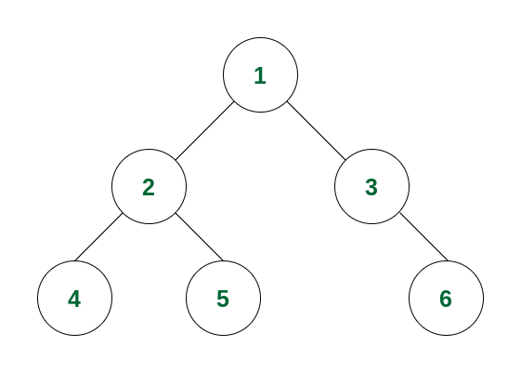
Geeks for Geeks Tutorials
https://www.geeksforgeeks.org/preorder-traversal-of-binary-tree/
https://www.geeksforgeeks.org/inorder-traversal-of-binary-tree/
https://www.geeksforgeeks.org/postorder-traversal-of-binary-tree/
Running Example

Slide 25
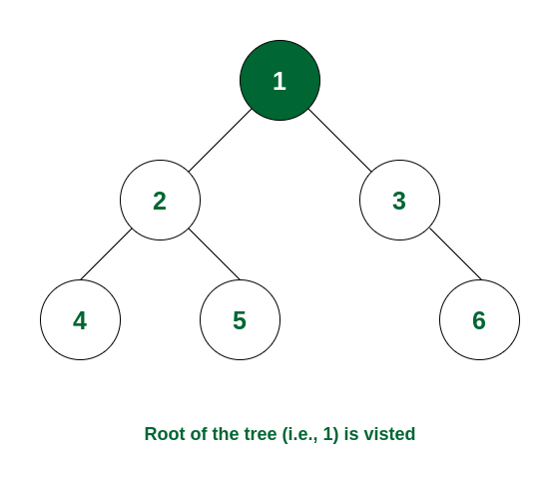
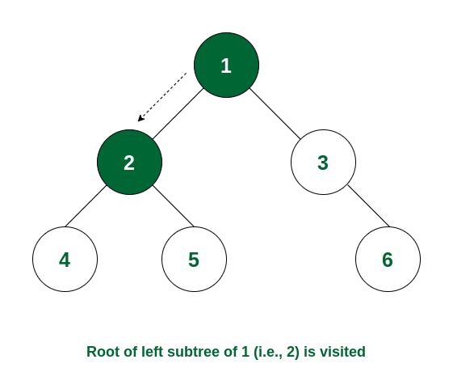
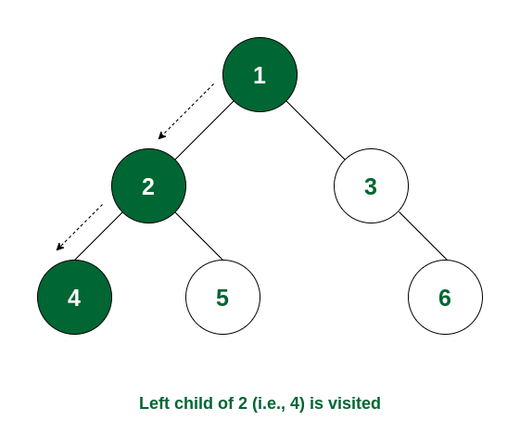
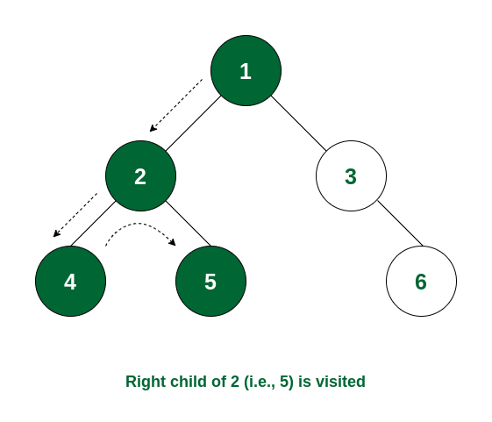
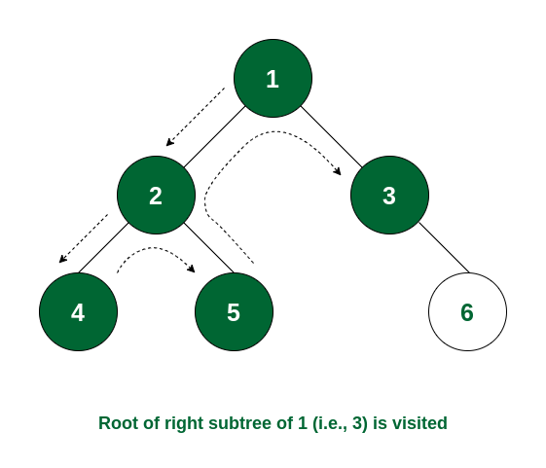
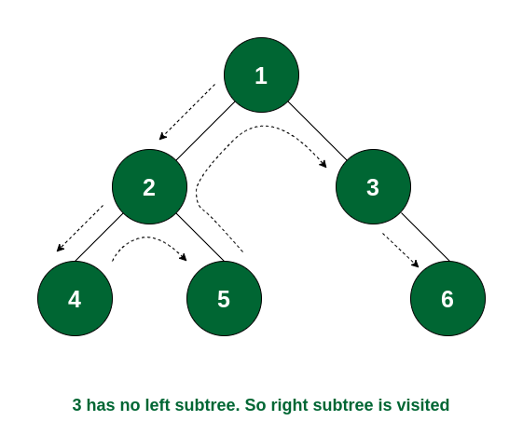
Pre-order traversal of nodes is 1 -> 2 -> 4 -> 5 -> 3 -> 6

Slide 26
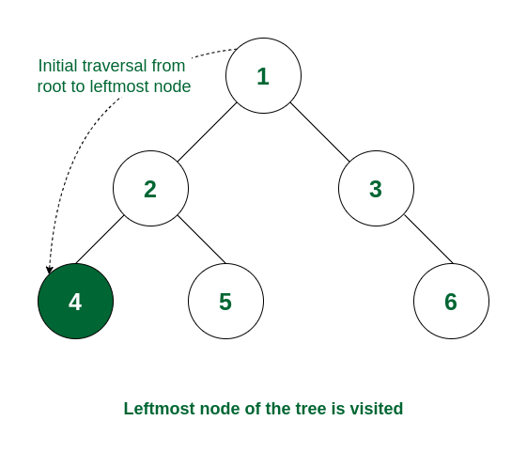
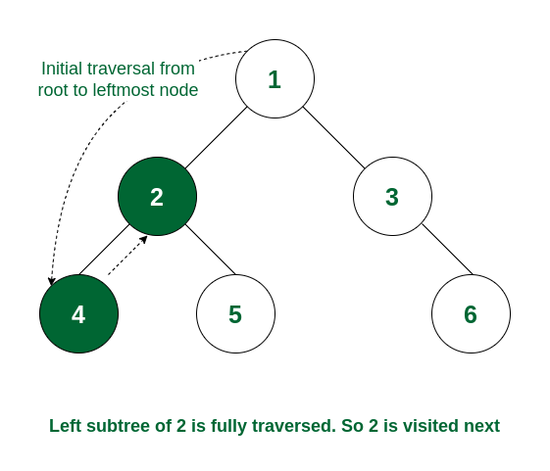
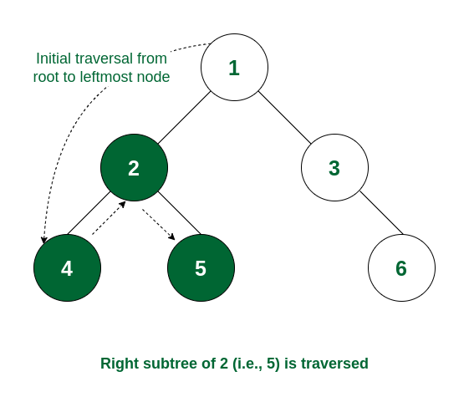
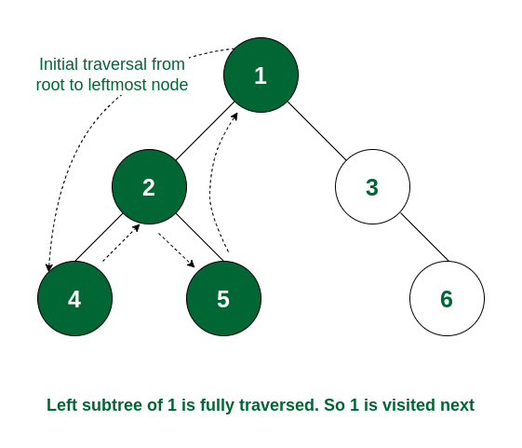
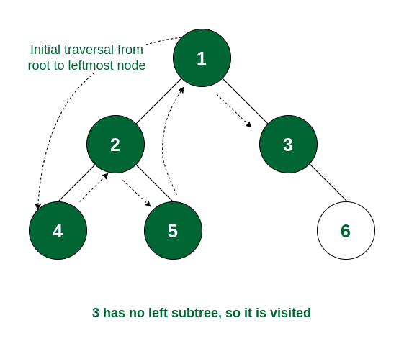
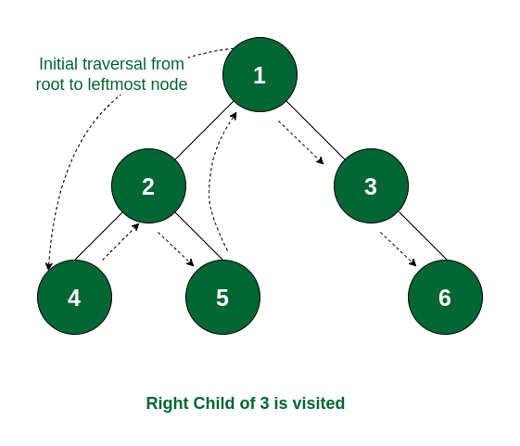
In-order traversal of nodes is 4 -> 2 -> 5 -> 1 -> 3 -> 6.

Slide 27
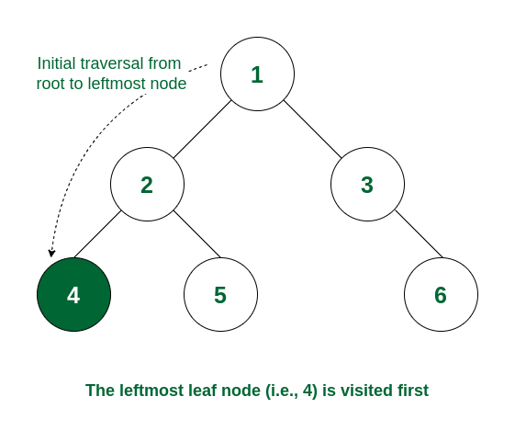
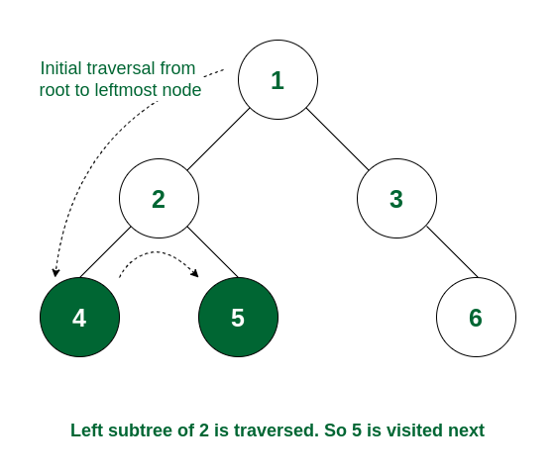
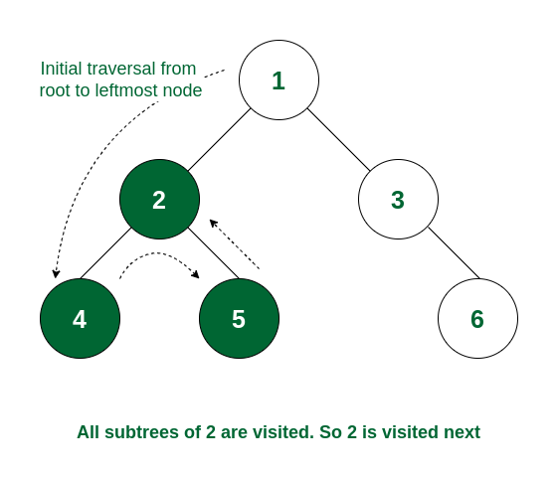
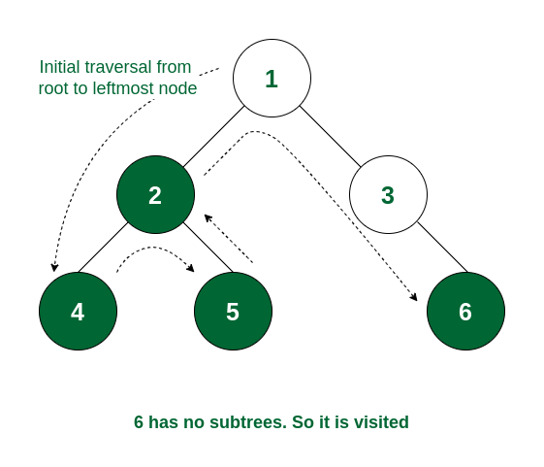
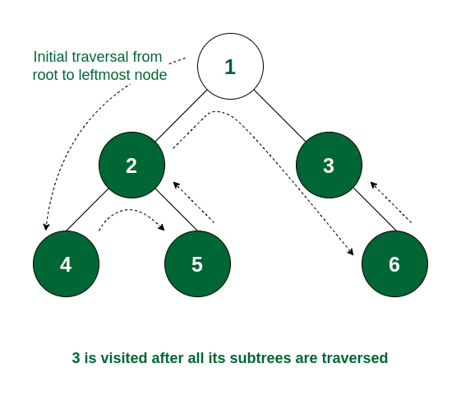

Post-order traversal of nodes is 4 -> 5 -> 2 -> 6 -> 3 -> 1

Slide 28
Summary of Traversals
Pre-order traversal:
Begins at the root, ends at the right-most node
In-order traversal:
Begins at the left-most node, ends at the rightmost node
Post-order traversal:
Begins with the left-most node, ends with the root

Slide 29
Motivation for Binary Search Tree
Agra
Beijing
Chicago
Essen
Lagos
Montreal
Quito
Binary Search - O(logn) search: get rid of half each time
toFind
Chicago
Sorted arrays are good for search, but bad for insertion/removal
root
So now we can do the same kind of fast searching we did within an array, but we can also get the benefit of a fast insert and a fast removal that a tree provides.
Essen
Beijing
Montreal
Agra
Chicago
Lagos
Quito

Slide 30
Binary Search Trees
E
Ordered, or sorted, binary trees.
Each node can have 2 subtrees.
Items to the left of a given node are smaller.
Items to the right of a given node are larger.
B
M
A
C
L
Q
Left subtree’s values must be lesser
Right subtree’s values must be greater
Which of these are binary search trees?
C
✗
D
✗
A
B
✗
42
42
42
42
32
12
32
65
32
65
12
32
12
✓
30
38
12
45
Binary Search Tree Animations | Data Structure | Visual How
https://www.youtube.com/watch?v=ymGjUOiR8Jg

Slide 31
BST Video Tutorials
Binary Search Tree : Overview
https://www.youtube.com/watch?v=6I3evyt9ApA
Binary Search Tree : Insert Overview
https://www.youtube.com/watch?v=KkEnuK-2Ymc
Binary Search Tree: Deletion Overview
https://www.youtube.com/watch?v=DkOswl0k7s4
Binary Search Trees (BST) Explained in Animated Demo
https://www.youtube.com/watch?v=mtvbVLK5xDQ

Slide 32
Searching a BST
E
Same fundamental idea as binary search of an array
B
M
toFind
C
Found it!
A
C
L
Q
Compare: E and C
Compare: B and C
Compare: C and C
toFind
P
How to implement this?
Compare: E and P
You could solve this with recursion.
Compare: M and P
Compare: Q and P
You could also solve it with iteration by keeping track of your current node.
Node is null
Not Found!

Slide 33
Searching a BST Iteratively
public class BinaryTree<E> {
TreeNode<E> root;
public boolean search(E toSearch) {
TreeNode<E> curr = root;
while (curr != null) {
if (toSearch < curr.getValue())
curr = curr.getLeftChild();
else if (toSearch > curr.getValue())
curr = curr.getRightChild();
else
return true;
}
return false;
}
}
It means that either the class E itself or one of its super classes implements Comparable
<E extends Comparable<? super E>> {
Do NOT change root pointer!
Doesn’t work with objects
while (curr != null) {
int comp = toSearch.compareTo(curr.getValue());
if (comp < 0)
curr = curr.getLeftChild();
else if (comp > 0)
curr = curr.getRightChild();
else // comp = 0
return true;
}
We need to do this over and over if not found
if calling object is less than parameter,
compareTo returns a value < 0
Are we done?
if calling object is greater than parameter, compareTo returns a value > 0
root
E
curr
t.search(’L’)
if calling object is equal to parameter, compareTo returns 0
B
M
Traverse down tree until:
end is reached
element is found
A
C
L
Q

Slide 34
Searching a BST Recursively
public class BinaryTree<E extends Comparable<? super E>> {
TreeNode<E> root;
private boolean search(TreeNode<E> p, E toSearch) {
if (p == null)
return false;
int comp = toSearch.compareTo(p.getValue());
if (comp == 0)
return true;
else if (comp < 0)
return search(p.left, toSearch);
else // comp > 0
return search(p.right, toSearch);
}
public boolean search(E toSearch) {
return search(root, toSearch);
}
}
Root of the tree we look at
Tree is empty
Found it!
look left
look right
root
E
p
B
M
t.search(’L’)
A
C
L
Q

Slide 35
Inserting into a BST
20
Where should we insert 7?
Insert 27?
Insert 8?
10
30
5
✗
25
✗
Option C
Option B
✓
7
27
Option A
8
✗
Option D: Either Option A or Option B are fine.
Notes:
Again, this is solved cleanly with either recursion or iteration.

Slide 36
Deleting from a BST
For the smallest value in a node's right subtree, its left child is null.
For the largest value in a node’s left subtree, its right child is null.
Delete 7
20
If leaf node: Delete parent’s link 7
12
10
30
Delete 5
✗
25
If only one child, hoist child
5
15
Delete 10
✗
✗
7
12
When a deleted node has two children, this gets tricky.
Find smallest value in right subtree
Find largest value in left subtree
Replace deleted element with it
OR
Replace deleted element with it
Then delet right subtree duplicate (12)
Then delete left subtree duplicate (7)

Slide 37
Binary Search Tree Shape
Which of the following Binary Search Trees could be the result of adding elements: 1, 2, 4, and 8 in some order.
These are all valid binary search trees!
A
B
C
D
1
2
1
2
2
1
8
4
1
4
4
8
4
2
8
8
Notes:
For valid trees, determine (on your own) an insertion order which would produce that tree?

Slide 38
Binary Search Tree Shape (Contd.)
A
✓
Inserting a node means making it a child of an existing node
Insert nodes as leaves
2
Root comes first
2
2
4
1
8
1
4
2
1
4
8
8
2
4
8
1
8 needs to be inserted AFTER 4
B
✓
2
2
Root comes first
2
8
1
4
2
1
8
4
1
8
2
8
4
1
4
4 needs to be inserted AFTER 8

Slide 39
Binary Search Tree Shape (Contd.)
C
1
Root comes first
1
2
Needs to be inserted AFTER 1
1
2
1
2
4
4
Needs to be inserted AFTER 2
The order in which we put elements into a BST impacts the shape, and what you‘ll see is that the shape of BST will have a huge impact on the performance of operations.
1
2
4
8
✓
8
Needs to be inserted AFTER 4
D
✓
1
1
Root comes first
1
4
4
Needs to be inserted AFTER 4
1
4
2
8
1
4
8
2
2
8
Both 2 and 8 needs to be inserted AFTER 4

Slide 40
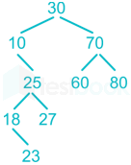
Traversal of a BST
When we perform in-order traversal on a binary search tree, we get the ascending order array.
Pre-order traversal:
Traversal sequence: 30, 10, 25, 18, 23, 27, 70, 60, 80
In-order traversal:
Traversal Sequence: 10, 18, 23, 25, 27, 30, 60, 70, 80
Post-order traversal:
Traversal sequence: 23, 18, 27, 25, 10, 60, 80, 70, 30
Notes:
Post-order traversal is 23, 18, 27, 25, 10, 60, 80, 70, 30.
In-order traversal traversal is 10, 18, 23, 25, 27, 30, 60, 70, 80
Preorder traversal is 30, 10, 25, 18, 23, 27, 70, 60,80
https://testbook.com/objective-questions/mcq-on-tree-traversal--5eea6a1139140f30f369eb98

Slide 41
Traversal of a BST
Pre-order traversal:
Begins at the root (7), ends at the right-most node (10)
Traversal sequence: 7, 1, 0, 3, 2, 5, 4, 6, 9, 8, 10
In-order traversal:
Begins at the left-most node (0), ends at the rightmost node (10)
Traversal Sequence: 0, 1, 2, 3, 4, 5, 6, 7, 8, 9, 10
Post-order traversal:
Begins with the left-most node (0), ends with the root (7)
Traversal sequence: 0, 2, 4, 6, 5, 3, 1, 8, 10, 9, 7
7
1
9
0
3
8
10
2
5
4
6
Notes:
https://stackoverflow.com/questions/9456937/when-to-use-preorder-postorder-and-inorder-binary-search-tree-traversal-strate

Slide 42
In-Order Traversal of a BST
In-order traversal of a BST visits the nodes in ascending order of their values, i.e., from smallest to largest. Here's why:
1. **Binary Search Tree Property**: In a BST, for any given node:
- The values in the left subtree are less than the value of the node.
- The values in the right subtree are greater than the value of the node.
2. **In-order Traversal Process**: This traversal method follows a specific sequence:
- Traverse the left subtree.
- Visit the root node.
- Traverse the right subtree.
3. **Resulting Order**: By first visiting all nodes in the left subtree (which are smaller), then the root, and finally all nodes in the right subtree (which are larger), in-order traversal naturally outputs the nodes in non-decreasing order.
This property makes in-order traversal particularly useful for retrieving data from a BST in sorted order.
Notes:
Citations:
[1] https://www.codecademy.com/resources/docs/general/binary-search-tree/inorder-traversal
[2] https://www.geeksforgeeks.org/tree-traversals-inorder-preorder-and-postorder/
[3] https://www.geeksforgeeks.org/binary-search-tree-traversal-inorder-preorder-post-order/
[4] https://www.freecodecamp.org/news/binary-search-tree-what-is-it/
[5] https://en.wikipedia.org/wiki/Binary_Search_Tree
[6] https://www.enjoyalgorithms.com/blog/introduction-to-binary-search-tree/

Slide 43
Performance Analysis of BST
Storing a dictionary as a BST
{ am, at, ate, ear, eat, east }
Structure of a BST depends on the order of insertion
isWord(east)
4
east
Best case: O(1)
ate
3
at
eat
isWord(a)
at
east
am
ate
Compared with 3 out of 7 words
am
ear
eat
ear
How does the performance of isWord relate to input size n?
Performance also depends on the actual structure of the BST
eat
isWord(String wordToFind)
Start at root
Compare word to current node
If current node is null, return false
If wordToFind is less than word at current node, continue searching in left subtree
If wordToFind is greater than word at current node, continue searching in right subtree
If wordToFind is equal to word at current node, return true
east
6
ear
ate
at
isWord(a)
am
Compared with all words
To optimize the worst case, we can modify the tree to control the max distance until leaf
Worst case: O(n)
height

Slide 44
Balanced BST
We want to keep the height down as much as we can while still maintaining the same number of nodes.
| LeftHeight – RightHeight | <=1
node
ate
✓
at
east
Left
Height
Right
Height
am
ear
eat
east
Which is the Balanced BST?
height ≈ log(n)
eat
at
eat
east
Especially if insert to BST in order!
am
ate
ear
 | Best case | Average case | Worst case
Linked List | O(1) | O(n) | O(n)
BST | O(1) | O(log n) | O(n)
Balanced BST | O(1) | O(log n) | O(log n)
ear
ate
at
am
How to keep balanced? TreeSet and TreeMap in Java API
isWord(String wordToFind)

Slide 45
BST vs. Hash Table
Time Complexity
Average case:
Hash Tables generally offer O(1) average time complexity for insertion, deletion, and search operations.
BSTs provide O(log n) time complexity for these operations, assuming the tree is balanced.
Worst case
Hash Tables can degrade to O(n) performance in cases of poor hash function design or many collisions.
BSTs maintain O(log n) performance even in the worst-case for self-balancing BST.
Ordered Operations
BSTs excel at operations requiring ordered data
In-order traversal yields sorted elements.
Efficient range searches and finding closest elements.
Hash Tables do not inherently maintain order, making these operations more difficult.
Notes:
Advantages of BST over Hash Table | GeeksforGeeks
Time complexity for Search, Insert, Delete operations is O(1) for Hash Table, O(log n) for Self-Balancing BST
BST advantages:
1. Can get all keys in sorted order by In-Order Traversal of BST
2. Order statistics, finding closest lower and greater elements, doing range queries, are easy to do with BSTs
3. With Self Balancing BSTs, all operations are guaranteed to work in O(logn) time

Slide 46
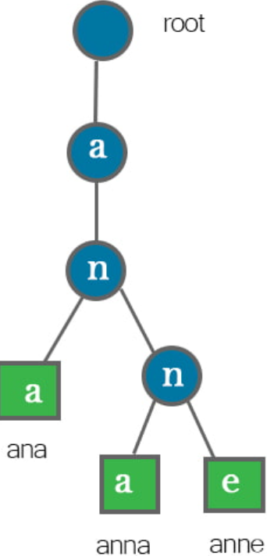
Tree vs. Trie
Structure and Purpose
Trees:
General-purpose data structure for representing hierarchical relationships
Each node can contain any type of data
Nodes typically have a value and references to child nodes
Tries:
Specialized tree structure for storing and retrieving strings efficiently
Also known as a prefix tree
Optimized for operations on strings or sequences
Node Content
Trees:
Each node stores a value directly
Tries:
Nodes typically do not store complete strings
The path from the root to a node represents a string or prefix
Characters are stored along the edges between nodes
https://romankurnovskii.com/en/posts/tree-vs-trie-data-structures/

Slide 47

Trie Data Structure
re(TRIE)ve
Storing a dictionary as a (balanced) BST
O(log n)
ear
at
east
BSTs don't take advantage of shared structure
a
ate
eat
a e r s t
Tries: Use the key to navigate the search
a e r s t
a e r s t
Finding “eat”
a
Adding “eats”
a e r s t
O(k)
a e r s t
Not all nodes represent words
Nodes can have more than 2 children
at
a e r s t
a e r s t
a e r s t
a e r s t
ear
eat
ate
a e r s t
a e r s t
Trie Data Structure (EXPLAINED)
https://www.youtube.com/watch?v=-urNrIAQnNo
east
eats
log₂(250000) $≈18$
Notes:
If there are n words in the dictionary, what is the worst-case time to find a word of length k?

Slide 48
Additional Resources
Trees and Binary Search Trees
https://www.geeksforgeeks.org/bfs-vs-dfs-binary-tree/ BFS vs DFS for Binary Tree
http://www.openbookproject.net/thinkcs/archive/java/english/chap17.htm -- explains trees, how to build and traverse it
http://algs4.cs.princeton.edu/32bst/ -- about binary search trees
Data structures: Binary Search Tree
https://www.youtube.com/watch?v=pYT9F8_LFTM
Tries
https://www.toptal.com/java/the-trie-a-neglected-data-structure --explains with solid example
https://www.topcoder.com/community/data-science/data-science-tutorials/using-tries/ -- explains as well as providing code

Slide 49
Quiz
How many common operations are performed in a binary tree?
a) 1
b) 2
c) 3
d) 4
ANS: c
Explanation: Three common operations are performed in a binary tree- they are insertion, deletion and traversal.

Slide 50
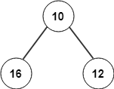
Quiz
The following given tree is an example for?
a) Binary tree
b) Binary search tree
ANS: a
Explanation: The given tree is an example for binary tree since has got two children and the left and right children do not satisfy binary search tree’s property, Fibonacci and AVL tree.

Slide 51
Quiz
1. **What is the sequence of nodes visited in a Preorder traversal?**
- a) Left, Root, Right
- b) Root, Left, Right
- c) Left, Right, Root
- d) Right, Root, Left
2. **Which traversal method is used to get nodes of a Binary Search Tree in ascending order?**
- a) Preorder
- b) Inorder
- c) Postorder
- d) Level order
3. **In a Postorder traversal, when is the root node visited?**
- a) First
- b) After visiting the left subtree
- c) After visiting both left and right subtrees
- d) Before visiting any subtree
ANS: b
ANS: b
ANS: c

Slide 52
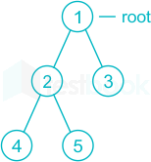
Quiz
Pre-order traversal:
Traversal sequence: 12453
In-order traversal:
Traversal Sequence: 42513
Post-order traversal:
Traversal sequence: 45231
Notes:
Pre-order of above tree = 12453
In order of above tree = 42513
Postorder of above tree = 45231

Slide 53
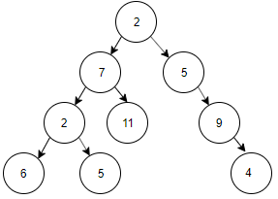
Quiz
Pre-order traversal:
Traversal sequence: 2, 7, 2, 6, 5, 11, 5, 9, 4
In-order traversal:
Traversal Sequence: 6, 2, 5, 7, 11, 2, 5, 9, 4
Post-order traversal:
Traversal sequence: 6, 5, 2, 11, 7, 4, 9, 5, 2

Slide 54
Quiz
Given: Pre-order traversal of nodes is 1 -> 2 -> 4 -> 5 -> 3 -> 6; In-order traversal of nodes is 4 -> 2 -> 5 -> 1 -> 3 -> 6. What is the post-order traversal of nodes?
ANS: we know 1 is the tree root from pre-order traversal, so we know the left subtree has nodes 4,2,5, and right subtree has nodes 3,6, from in-order traversal 4 -> 2 -> 5 -> 1 -> 3 -> 6. We can draw the tree now and derive the post order traversal 4 -> 5 -> 2 -> 6 -> 3 -> 1
Pre-order traversal:
Begins at the root, ends at the right-most node
In-order traversal:
Begins at the left-most node, ends at the rightmost node
Post-order traversal:
Begins with the left-most node, ends with the root

